Slide 1



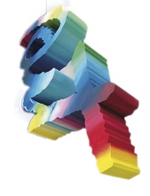
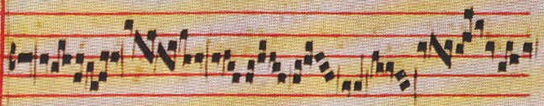
ERASMUS PLUS
NOTES OF EUROPE
NOE
I.I.S.S E. Giannelli Musical High School
CASARANO

Slide 2
LABORATORY
Of Study-Research on the origins of thinkers about EUROPEAN CONCEPT OF MUSIC

Slide 3
Workshop led
by:
F. Protopapa;
M. Potenza
S. Rizzo

Slide 4
Student-Researchers
Arlotta Sara (Lyric Singing)
Carafa Gabriele (Piano)
Cucinelli Leonardo (Guitar)
Fattizzo Sharon (Piano)
Gerotto Matteo (Doublebass)
Greco Chiara (Lyric Singing)
Lazzari Maria Irene (Percussion)
Marsala Chiara (Flute)
Pizzolante Stefano (Piano)
Scarciglia Luana (Lyric Singing)
Sergi Pierluigi (Guitar)

Slide 5
"MAGNA GRECIA AND
TERRA D'OTRANTO" CRADLE OF EUROPEAN MUSIC INNOVATIONS

Slide 6
ANCIENT THINKERS OF MAGNA GRECIA.
• PYTHAGORAS FROM METAPONTO
• ARISTOXENUS FROM TARANTO
• ARCHITAS

Slide 7
MAGNA GRECIA
MAGNA GRECIA WAS A COLONIAL SETTLEMENT IN SOUTHERN ITALY AND INCLUDED VAST AREAS OF CURRENT APULIA, BASILICATA, CALABRIA, CAMPANIA
FROM VII CENTURY B. C. TO III CENTURY B.C.

Slide 8
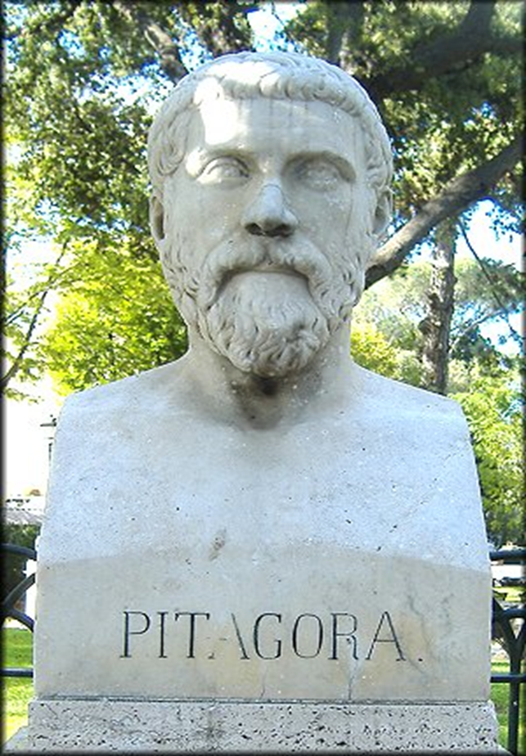
PYTHAGORAS
NAME: Pythagoras
SURNAME: From Samos
PERSONAL DETAILS: Samos, 570
a.C. about – Metaponto, 495
a.C. about
AREAS OF INFLUENCE: Egypt,
Babylon, Crotone, Magna
Greece (Taranto, Metaponto)
PROFESSION: mathematician,
political, miracle worker,
astronomer, scientist
WORKS: Philosophical, Religious, Mathematics, Music Essays and Works

Slide 9
REASONS FOR RESEARCH
Pythagoras was the first philosopher to realize the close relationship between musical phenomena and mathematical studies.
He was responsible for the theory of the monochord and through the evolution of it, he reaches the “PYTHAGOREAN TUNING ”
composition.

Slide 10
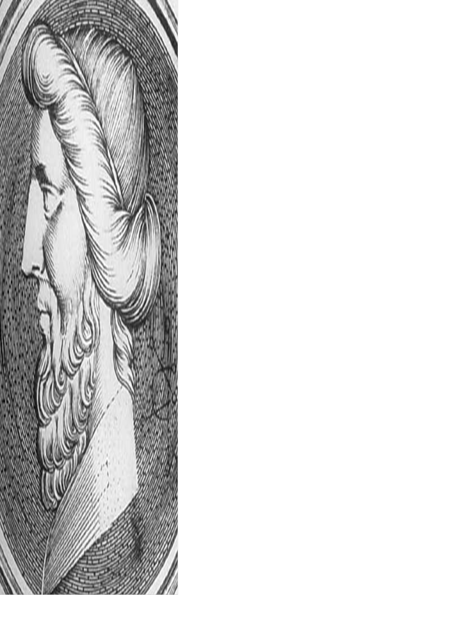
ARCHITAS
Name: Architas
Surname: From Taranto
Personal date: 428 a.C. –360 a.C
Zone of influence: Taranto-Mattinata
Profession: ancient greek philosopher, mathematician and politician
Works:Philosophical, political, mathematical, musical Essays and Works, as well as major mechanical studies.

Slide 11
RESEARCH REASONS
Archytas performs studies relating to the height of the sounds by determining their speed of propagation; He described the construction of musical scales in the three genres: diatonic, chromatic and enharmonic.
Moreover, he theorized that the octaves could be divided into 12 semitones and pointed to a frequency ratio that would allow the partition.

Slide 12
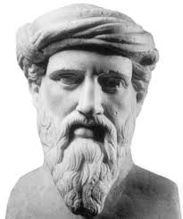
ARISTOXENUS
Nome: Aristoxenus
Cognome: From Taranto
Dati anagrafici: 375 a.C. –after 322 a.C.
Area d ‘ influenza : Taranto
Professione: composer and ancient greek philosopher, peripatetic and music theory writer.
Opere:Philosophical, Religious, Mathematical, Musical Essays and Works.

Slide 13
REASONS FOR RESEARCH
He ascribes to music educational and teaching ethical value. He employs music as aesthetic discipline for the harmonious development of the soul and body. In "Elements of Harmony" recognizes the importance of the musical memory as a fundamental part of the process of reproduction. For Aristoxenus task of the composer is to create matches between word-rhythm-sound.

Slide 14
COMPOSERS AND THINKERS FROM "Terra d'Otranto"
Girolamo Melcarne
Leonardo Leo
Giovanni Paisiello

Slide 15
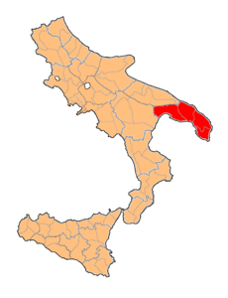
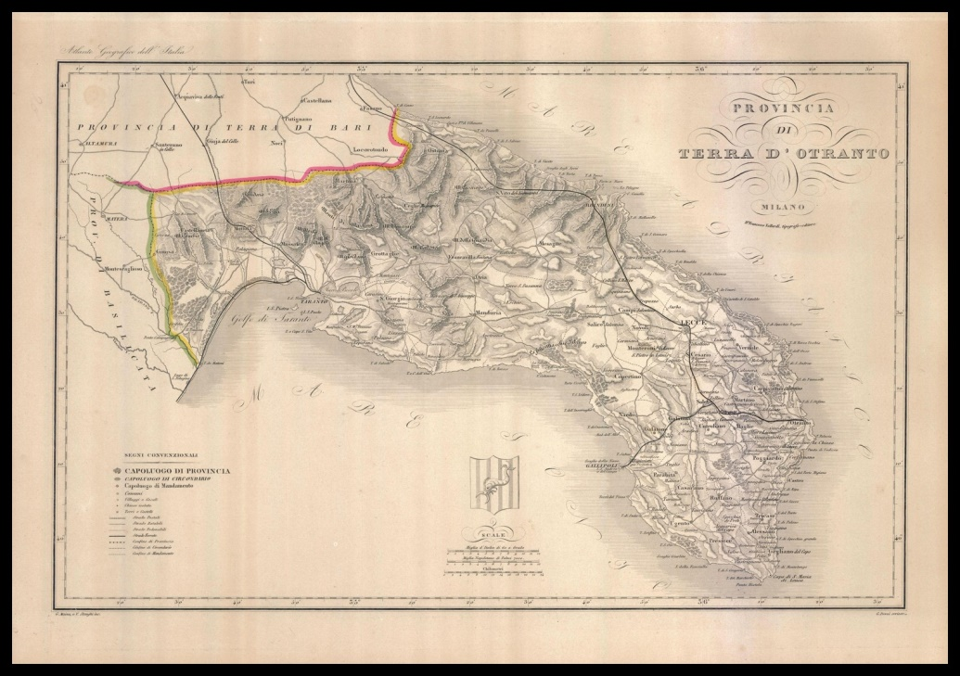
TERRA D’OTRANTO
( 1231 -1861)
Province of : Kingdom of Sicily, Kingdom of Naples and the Kingdom of the Two Sicilies Finally broken up in 1861 with the Unification of Italy.

Slide 16
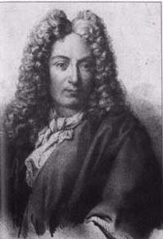
“GIROLAMO MELCARNE IL MONTESARDO”
NAME: Girolamo
SURNAME: Melcarne (said il Montesardo).
PERSONAL DATE:
He was born in Alessano, around 1580-1645 circa.
ZONE OF INFLUENCE: Moves Tricase, Rome, Florence, Ancona,
Bologna, Naples
PROFESSION:
Organist in the Roman Basilica of Santa Maria in Trastevere, singer in the Basilica of San Petronio in Bologna, choirmaster in Ancona and Fano's Cathedral.
WORKS:
The "little booklet of ballets" alphabetic guitar tablature. Composer of two madrigals for five mixed voices “E così vagli il pianto ch’esc’o mio sol, da bei vostr’occhi” and “Quando l’alba novella adorn’il crin di rose” and four sacred motets up to eight voices. Florentine-style songs "O lucky days". With the work "The glad days in Naples" he tries to praise Naples and its beauty.

Slide 17
RESEARCH REASONS
Girolamo Montesardo theorizes a new alphabetic tablature for guitar, from which the famous work 'ballet on Spanish guitar', as well as a new instrument tuning system.

Slide 18
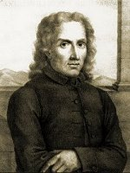
Leonardo Leo
SURNAME: LEO
NAME: LEONARDO ORONZO SALVATORE
PERSONAL DATE: IN SAN VITO DEI NORMANNI IL 5 AUGUST 1694-NAPOLI 31 OCTOBER 1744
ZONE OF INFLUENCE: ROME-NAPLES-LORETO
PROFESSION: ITALIAN COMPOSER
WORKS:SACRED MUSIC AND ORATORIES, COMIC OPERAS AND DRAMAS, MUSIC AND CHAMBER ORCHESTRA
CONCERT IN G MAJOR PER FLUTE, 2 VIOLINS AND BC SYMPHONY IN A MAJOR
6 CONCERTS FOR CELLO
ORATORY FOR THE HOLY CHRISTMAS.

Slide 19
RESEARCH REASONS
Famous composer and founder of the Neapolitan school of the eighteenth century.
Greatly important his instrumental compositions which will influence all composers of the classical period.

Slide 20
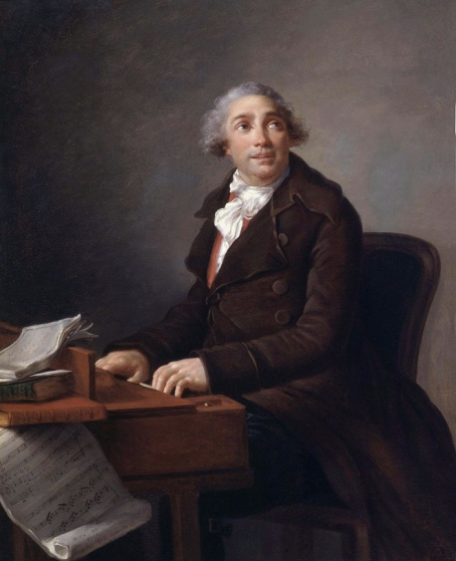
GIOVANNI PAISELLO
Name: GIOVANNI
Surname: PAISIELLO
Personal Date: 9 MAY 1740
5 JUNE 1816
Zone of Influence: TARANTO, NAPLES, PARIS, RUSSIA, VIENNA
Profession: COMPOSER
Works :NINA, Nitteti, THE BARBER OF SEVILLE, THE SERVANT MISTRESS, THE KING TEODORO IN VENICE, DEMETRIO, THE IDOL OF CHINA, ARAB CORTESE, ARTAXERXES, DARDANE '

Slide 21
RESEARCH REASONS
Composer of the greatest exponents of the Comic Opera from Naples.
His works were performed in all the major theatres of Europe, contributing to the creation of the Italian opera style.

